Slide 1

17BIT0368
Capstone
Offcampus+mini-project

Slide 2
Where do I work at?

Slide 3


Slide 4
My First Project Assigned(During Capstone Project)
flow.twimbit.ai

Slide 5
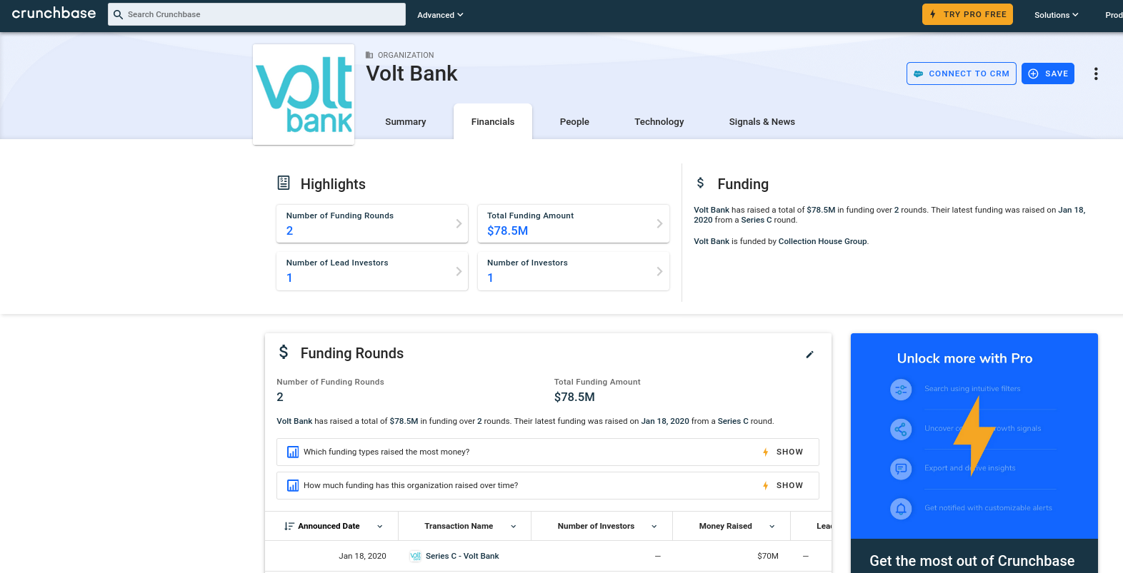

Slide 6
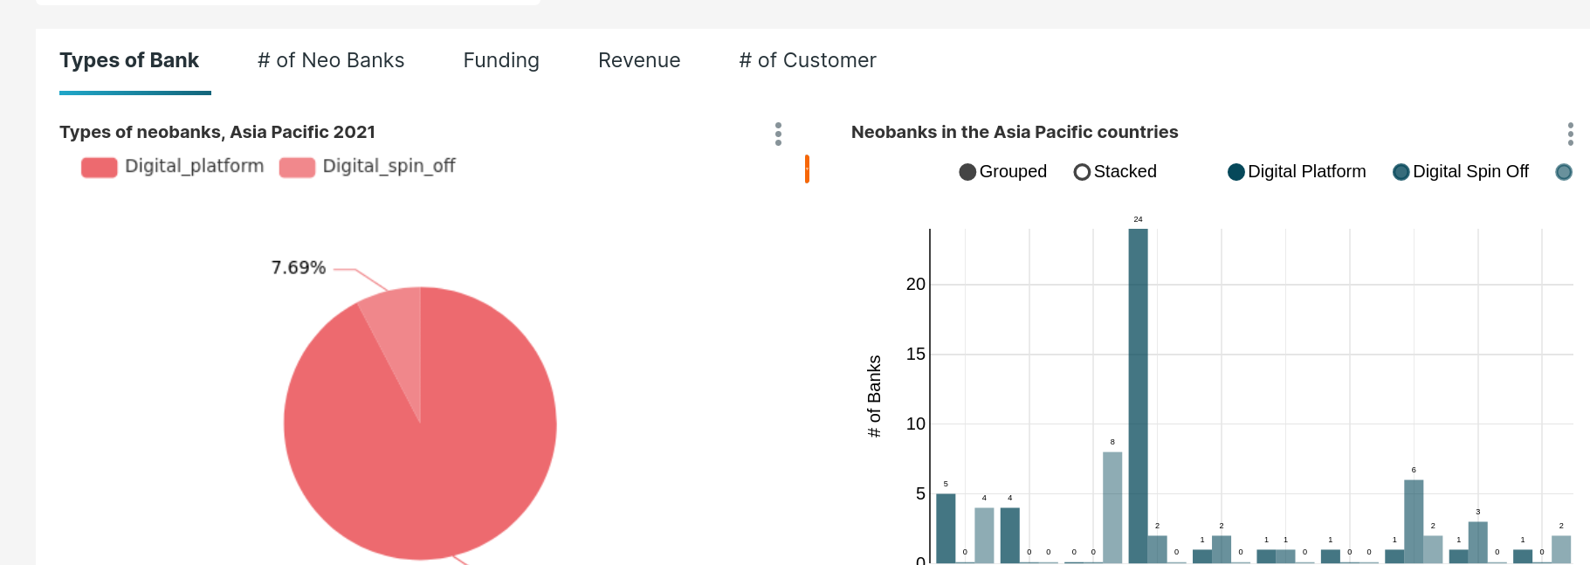
Hence making
FLOW.TWIMBIT.AI

Slide 7
Capstone Project Assigned - Dash.Twimbit.Ai

Slide 8


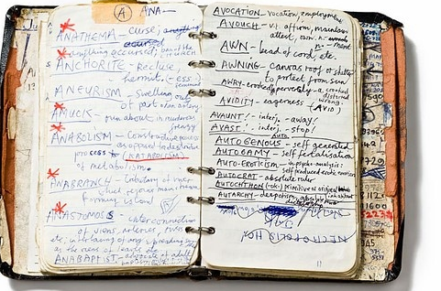
The Problem
Analysing vast amount of data
Find true fact from the information
Context loss in heap of data
Time consuming and labour intensive process

Slide 9

Twimintel.ai
Tabs
keywords
It’s a system of ML and AI tools that process vast amount of textual and statistical information to generate them as simplifies context based intelligence
Problem Statement
Twimintel.ai

Slide 10

Log the information
Collect all the relevant links and add it to our query base
Research analyst open all relevant tabs in there browser related to the query
Using a extension, they collect and save all those tabs to our system with keywords and problem statement

Slide 11
Analyse the Links
text
Embedding
vectors
models
html
images
Crawl
Parse
Store

Slide 12
Improving the system
Expand the corpus
Improve the models
Feedback 1 model
Add new relevant links to corpus
Better model
Discard non relevant data
New Query Data
Feedback 2 model

Slide 13
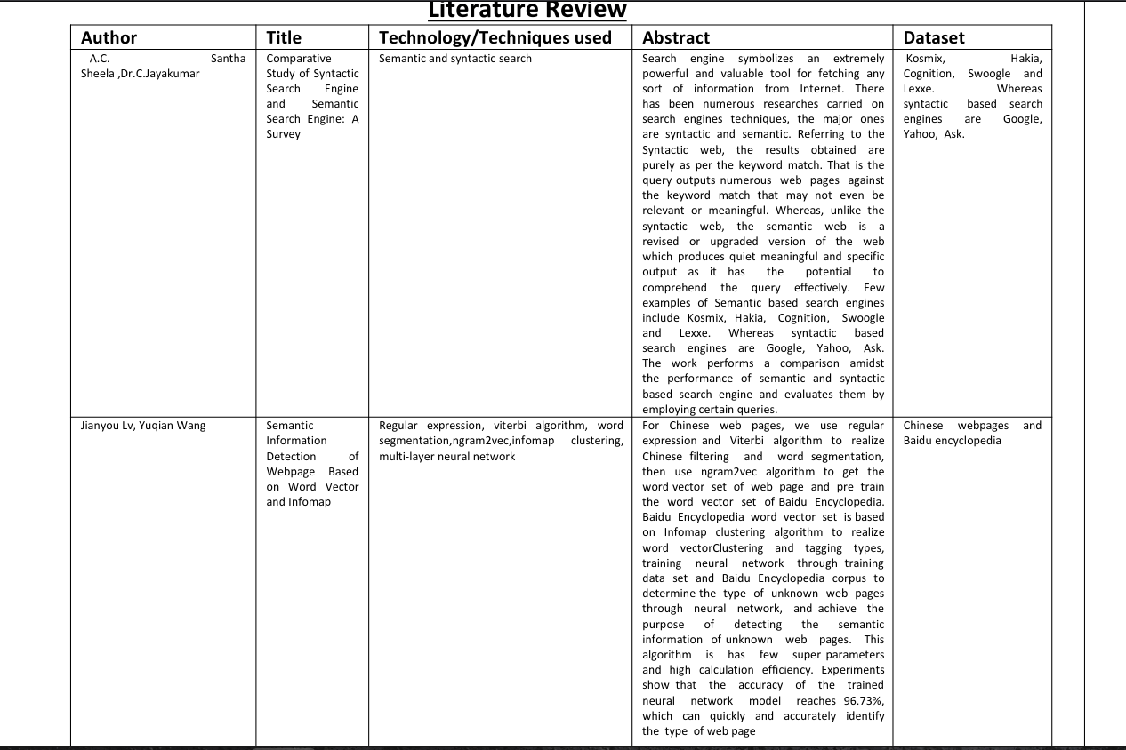
Literature Survey

Slide 14
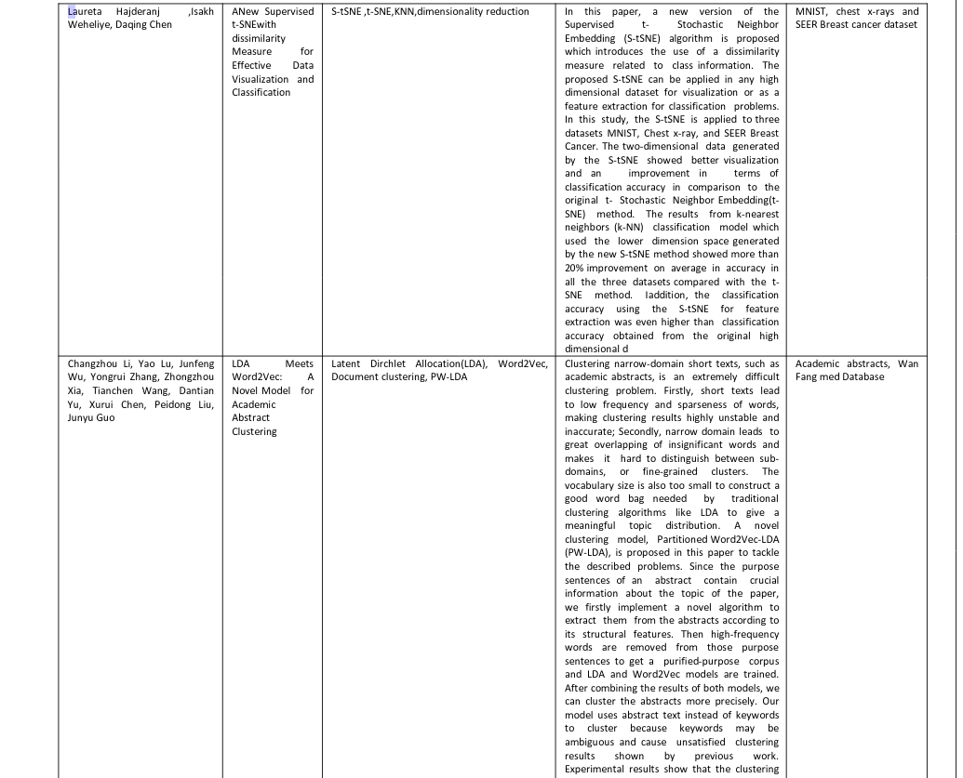
Literature Survey

Slide 15
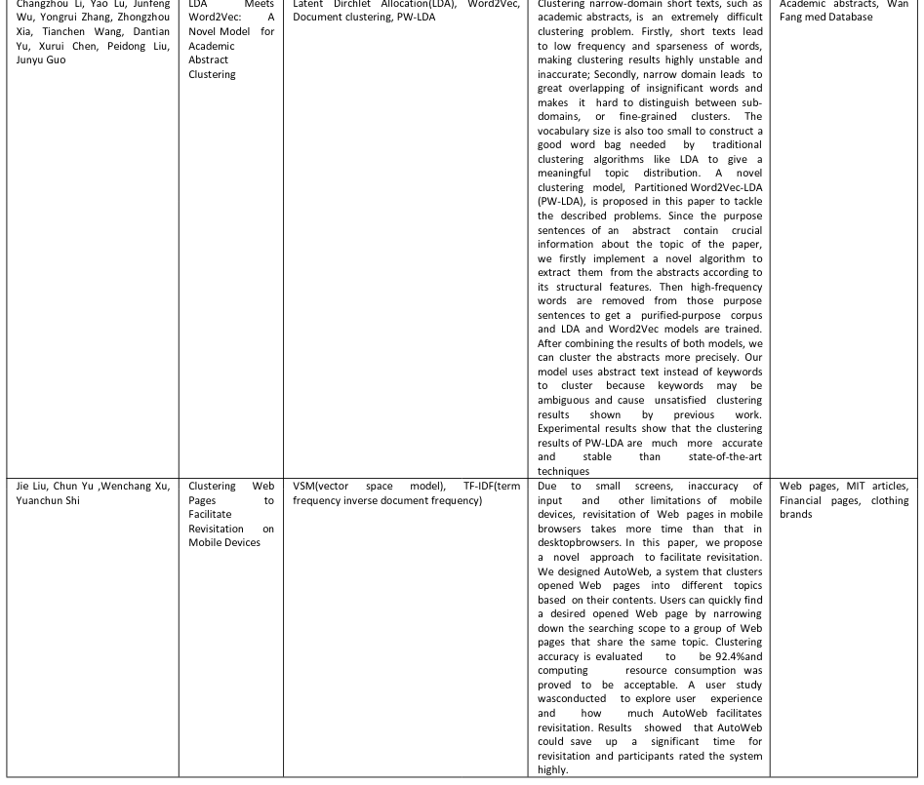
Literature Survey

Slide 16
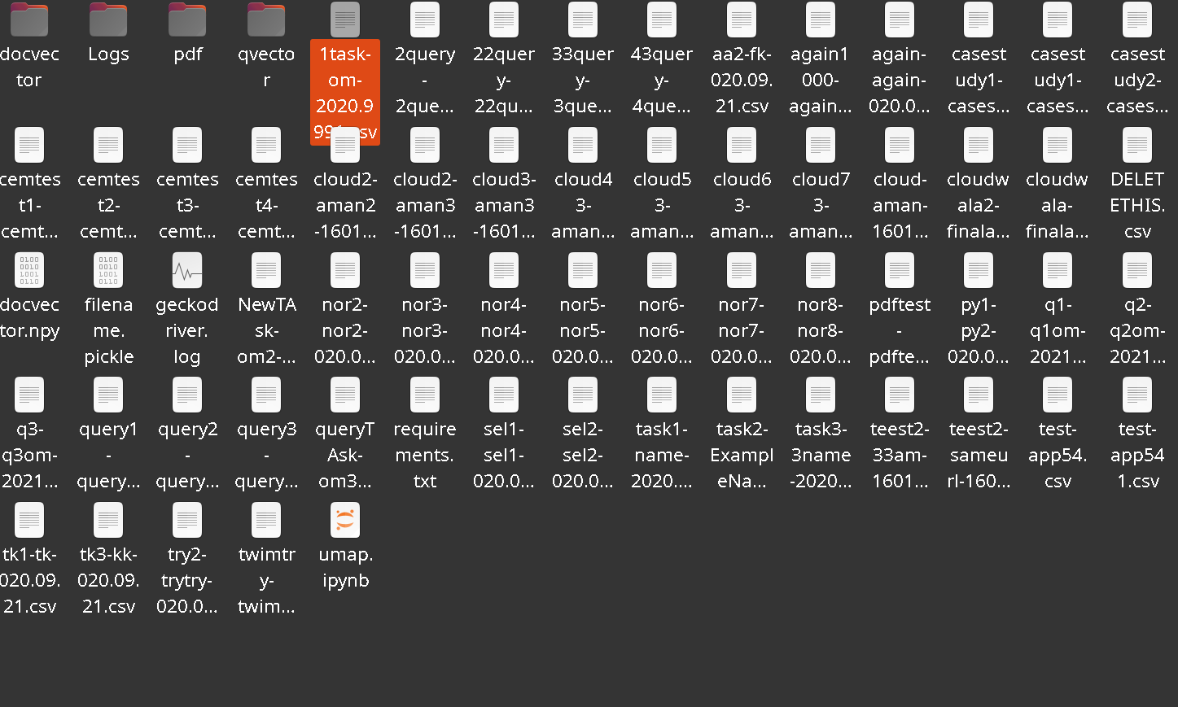
Process
The Data!
We linked the chrome extension to Monday.com Integration and we further linked it with our dashboard. Since the project was going to roll out to limited research analysts, we used CSV’s as the data

Slide 17
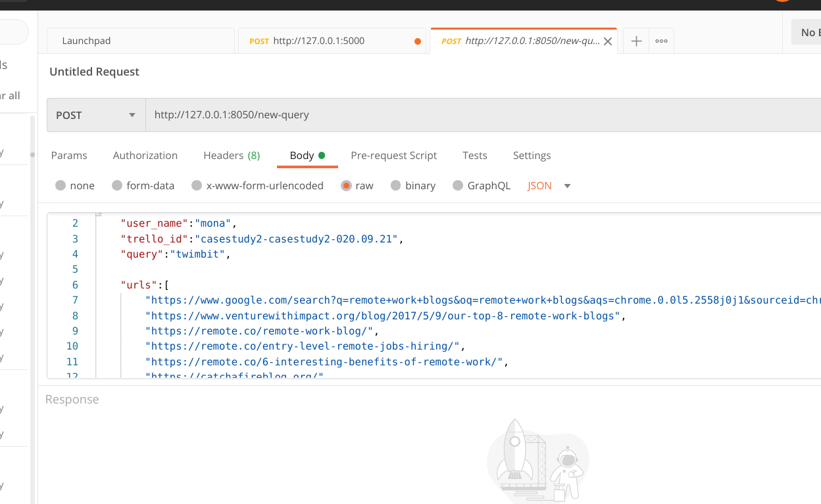
The Postman Query. As the chrome extension was to be built by the frontend team. I used Postman to simulate the extension API requests

Slide 18
Final Dashboard Screenshot

Slide 19
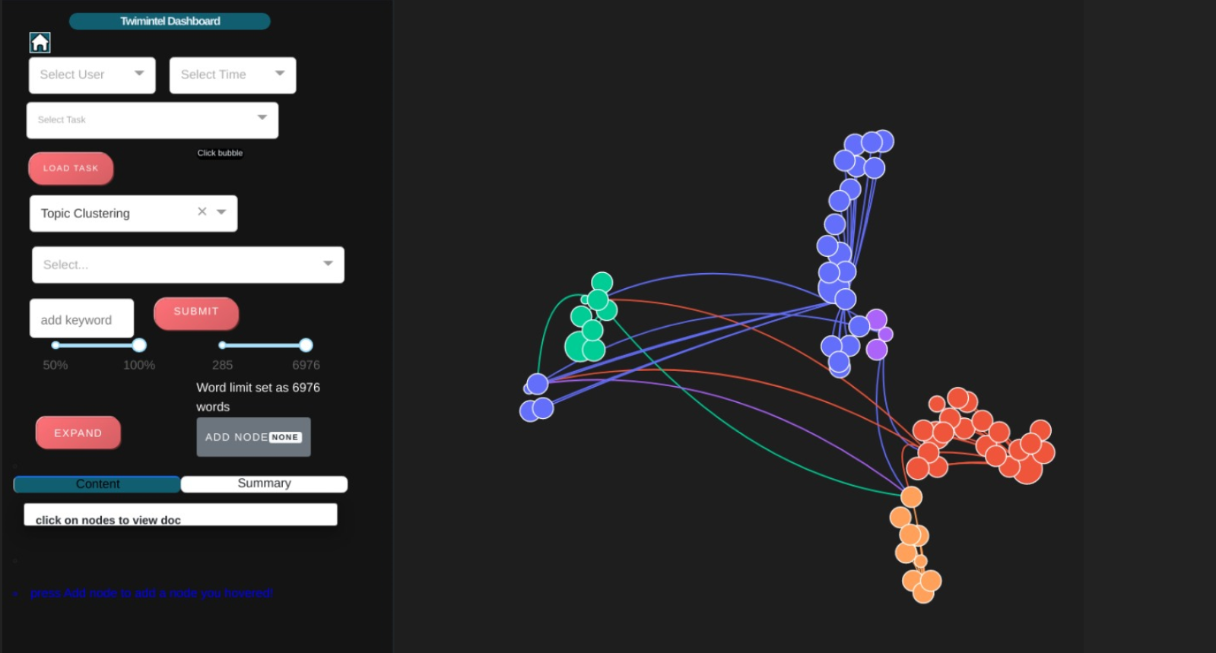
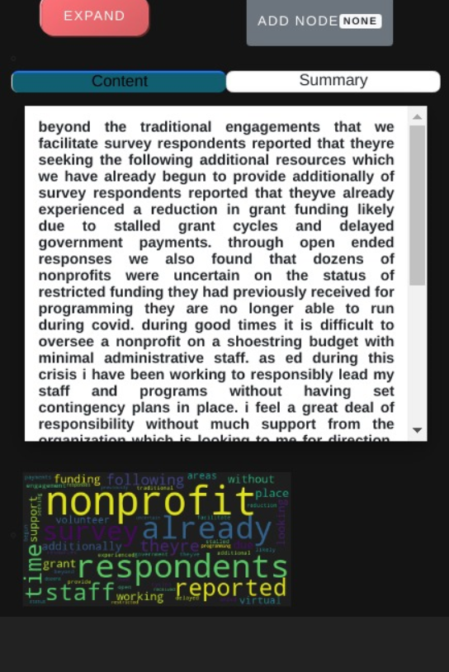

Slide 20
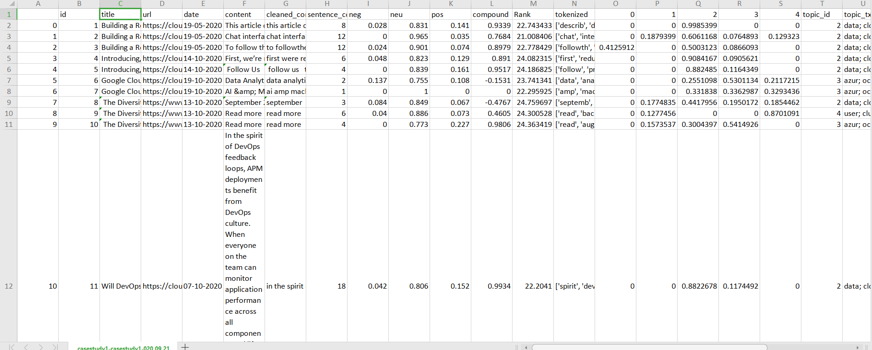
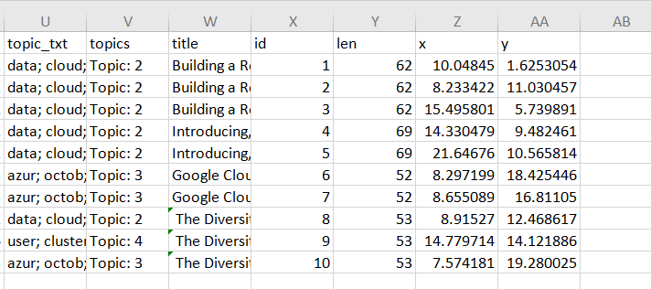

Slide 21
Vellore Rainfall Forecasting
Inhouse Project Under Guide Kathiravan sir

Slide 22
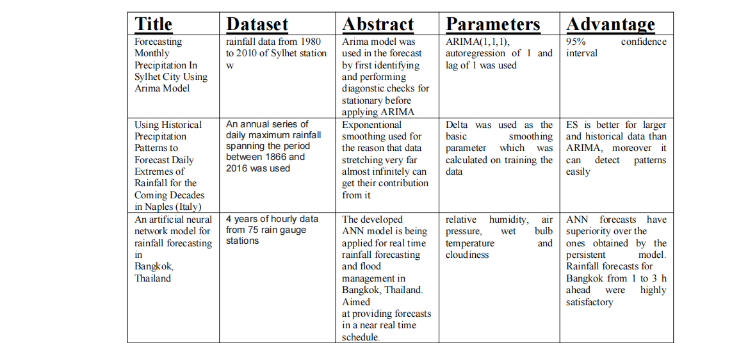
Literature Survey

Slide 23
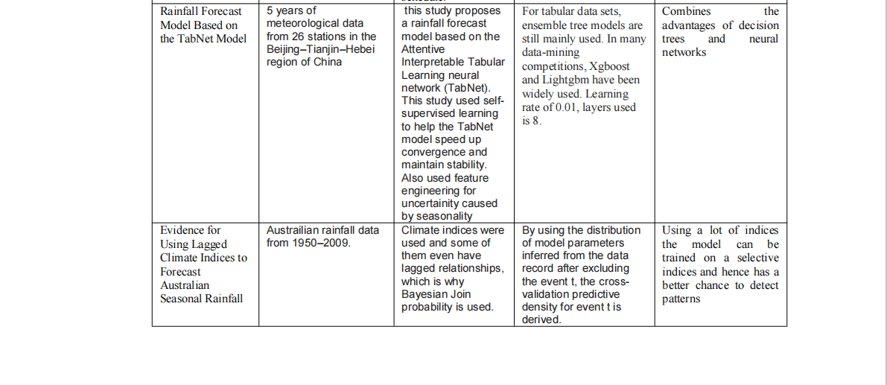

Slide 24
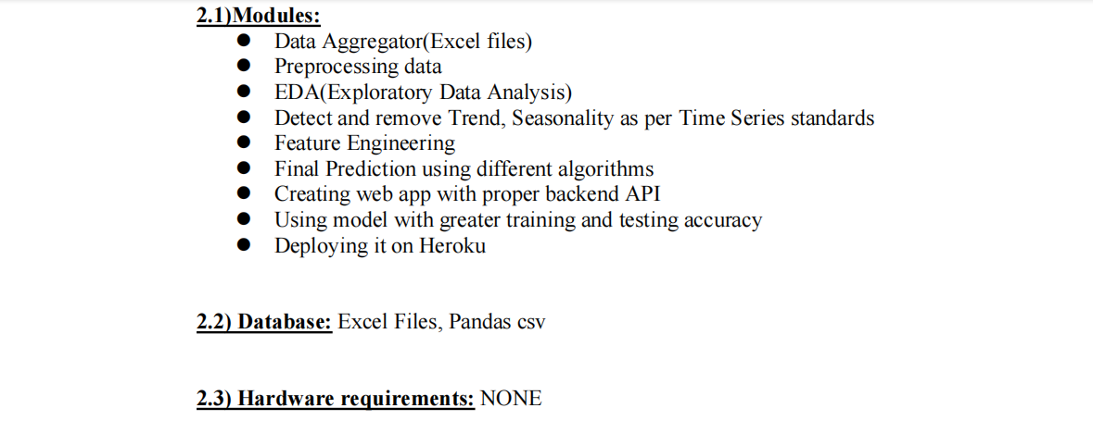
Detailed Design

Slide 25
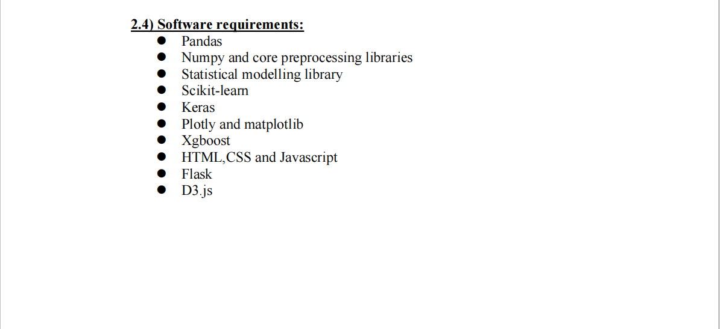

Slide 26

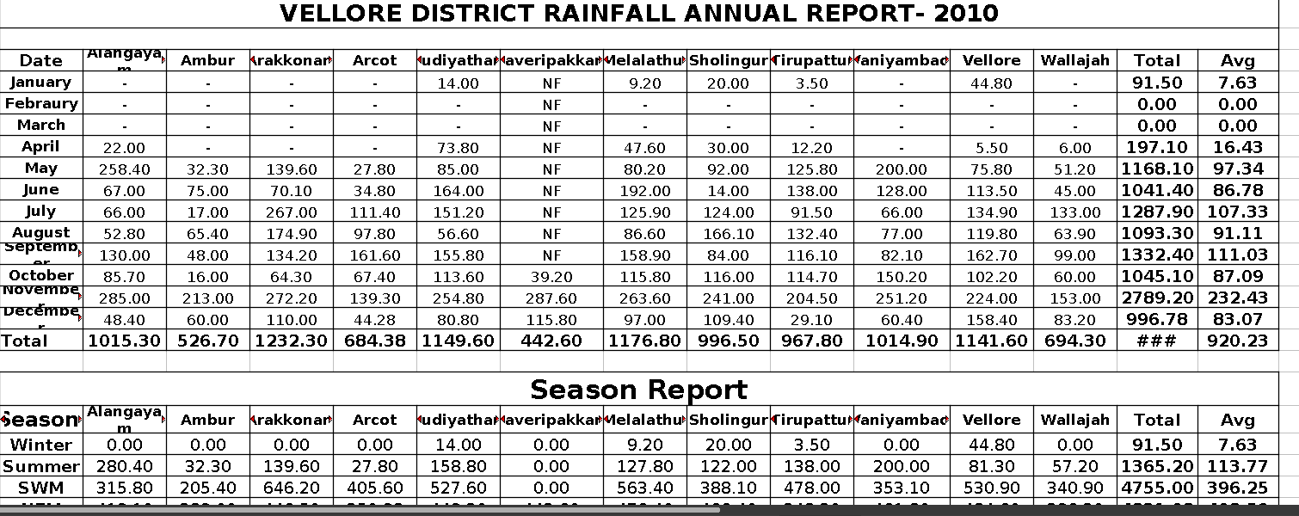
Dirty and Raw Data

Slide 27
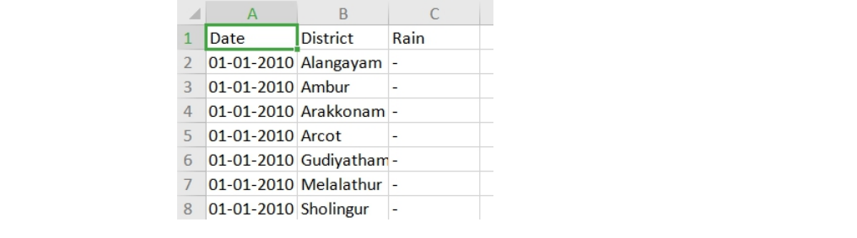
After Preprocessing and aggregrating into 1 dataset
Dataset Shape 46293*3

Slide 28
What is a Trend in a dataset
Trend:The trend is the component of a time series that represents variations of low frequency in a time series, the high and medium frequency fluctuations having been filtered out. This component can be viewed as those variations with a period longer than a chosen threshold (usually 8 years is considered as the maximum length of the business cycle)

Slide 29
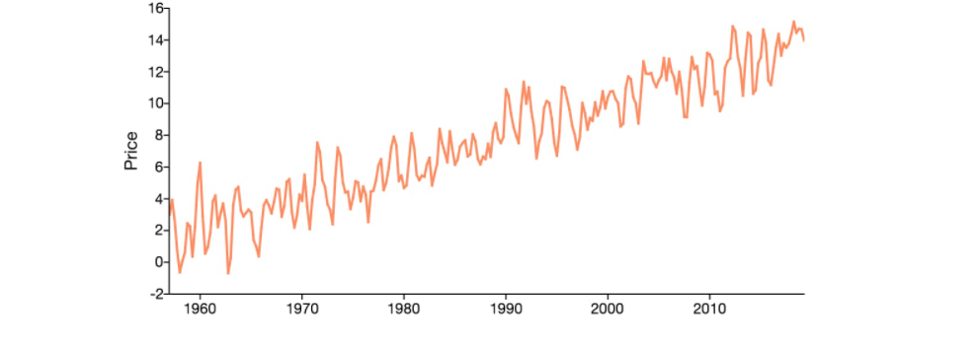
Example of trend in a Datset

Slide 30
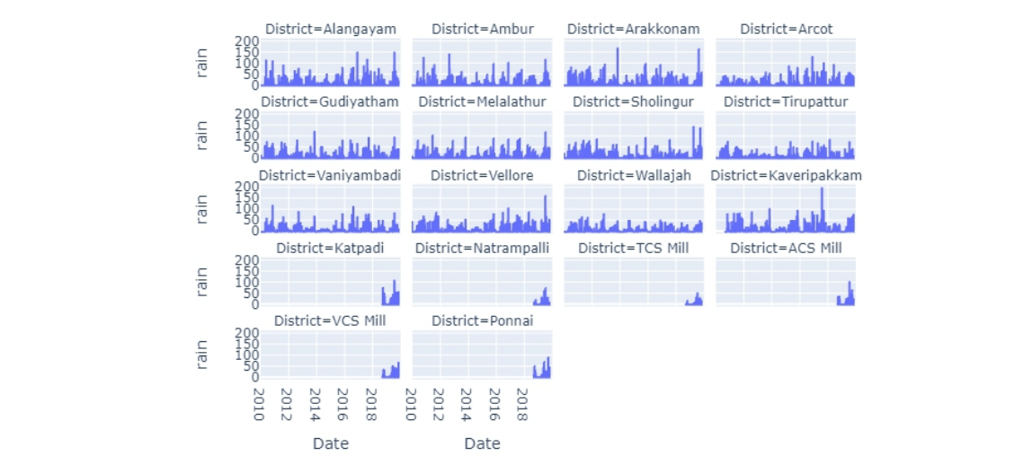
Does our Dataset contain trend? NO!
Run-way plot

Slide 31
What is seasonality?
Seasonal variation, or seasonality, are cycles that repeat regularly over time. A repeating pattern within each year is known as seasonal variation, although the term is applied more generally to repeating patterns within any fixed period.
Example: Ice cream items are sold more during summer and less in winter irrespective of what year it is and cycle continues.

Slide 32
Why do we check for seasonlity and trend?
A series is stationary, only if the series does not contain trend or seasonality.
If a series is stationary, it indicates no autocorrelation with its lagged self. Meaning the values are not a function of time and do not depend on time.
Furthermore we can only apply ARIMA and Exponential Smoothing on Stationary Time series data

Slide 33
Using a test to detect seasonality
We use Augmented Dicky-Fuller test. It is a unit root test for seasonality.
null hypothesis for this test is that there is a unit root. •
alternate hypothesis differs slightly according to which equation you’re using. The basic alternate is that the time series is stationary (or trend- stationary).
What is a unit root test?

Slide 34
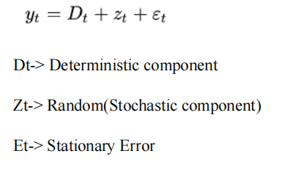
What is Unit root test?
Unit root tests can be used to determine if trending data should be first differenced or regressed on deterministic functions of time to render the data stationary. Moreover, economic and finance theory often suggests the existence of long-run equilibrium relationships among nonsta- tionary time series variables.

Slide 35
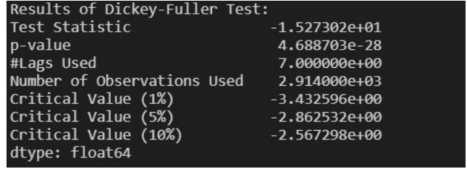
Test-1 Using Autolag
Lag in a time series data is displacement of the data by an order of t, where t is the assumed time period where seasonality occurs. We will be using AutoLag in our Augmented Dicky Fuller test, where the test will automatically detect a lag.
From the above test the important results for us are the Test Statistic and Critical Value(10%)(this is the benchmark critical value) We observe that the critical value - 3.432 is greater than Test statistic -15.273. The lag automatically detected is 7 -15.273 < -3.432 Test Statistic < Critical value We reject null hypothesis and accept the alternate hypothesis

Slide 36
This is a problem!
Our test using automatically chosen lag of 7, is concluding that our data is already stationary!
However, Rain is known to be a seasonal event!
Solution? use our own lag of more than >365

Slide 37
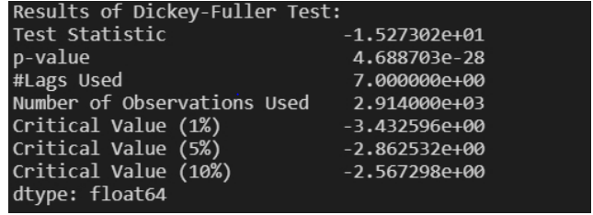
Test-2 using our own lag of 400
From the above test the important results for us are the Test Statistic and Critical Value(10%)(this is the benchmark critical value) We observe that the critical value - 2.56 is greater than Test statistic. -2.24 < -2.56 Test Statistic < Critical value We accept the null hypothesis.

Slide 38
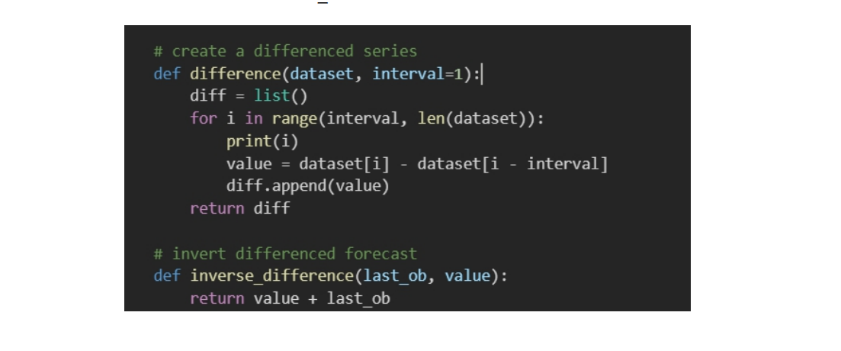
Using Differencing to make data stationary
we use an interval of 400 to create our differenced/shifted dataset

Slide 39
The ARIMA model
ARIMA stands for Auto Regressive Integrated Moving Average model. An autoregressive integrated moving average, or ARIMA, is a statistical analysis model that uses time series data to either better understand the data.
Autoregressive: A statistical model is Autoregressive if it it predicts the time series data from previous data. It seeks to use a lag to shift the time series data. A lag of k means it will predict the values using previous k terms of the dataset.ta set or to predict future trends.

Slide 40
Moving average is a simple statistical measure to calculate averages in a moving window. It is also used in technical analysis of stock data, which is a well known time series data. The formula is ARIMA(x,y,z). x determines the Autoregression lag to be used, moving average is determined by a lag z and y is used for integration, i.e the differencing order. We already have performed differencing hence we initalise this to 0 ARIMA(7,0,1)

Slide 41
Test Accuracy mean absolute error
We will be using a common metric for measuring error of various models in the future. MAE, mean absolute error is a great choice compared to other metrics. As some metrics tend to divide the error by the the true value, for the case of data containing 0’s it can lead to error reaching infinity. For MAE the error more close to 0.0 is better!

Slide 42
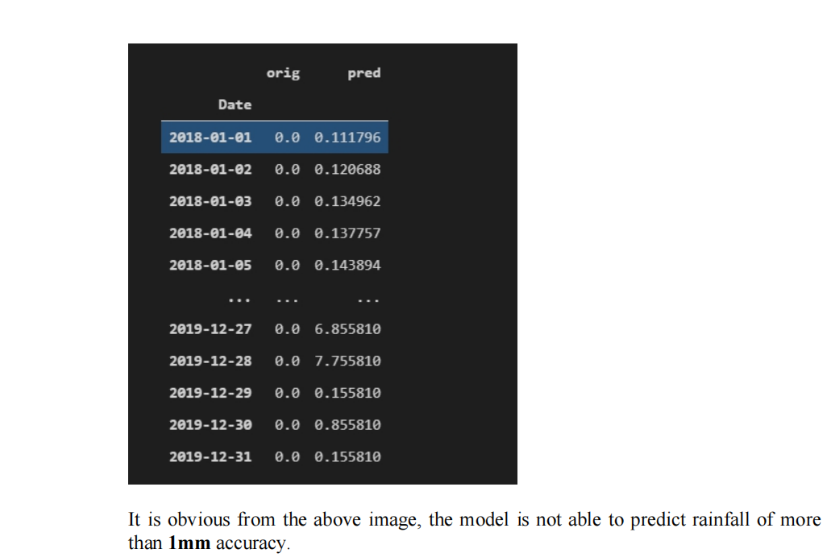
ARIMA TEST SCORE
Mean Absolute Error-> 4.143
The error is large and inefficient model.
It is obvious from the above image, the model is not able to predict rainfall of more than 1mm accuracy

Slide 43
The Holt-Winter Exponential Smoothing Model
Exponential smoothing was proposed in the late 1950s (Brown, 1959; Holt, 1957; Winters, 1960), and has motivated some of the most successful forecasting methods. Forecasts produced using exponential smoothing methods are weighted averages of past observations, with the weights decaying exponentially as the observations get older. In other words, the more recent the observation the higher the associated weight. This framework generates reliable forecasts quickly and for a wide range of time series, which is a great advantage and of major importance to applications in industry.

Slide 44
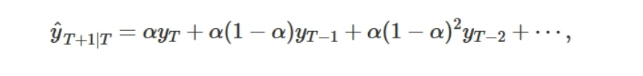
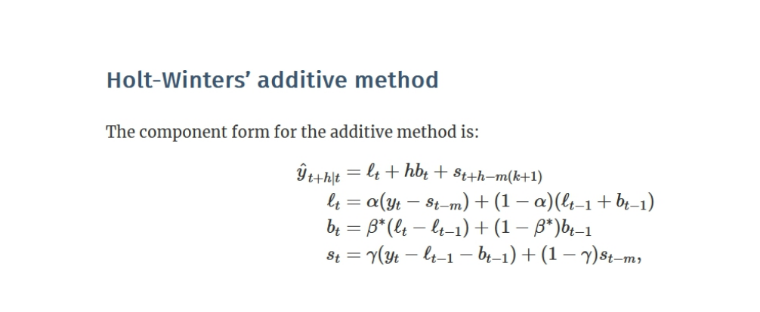
Here the alpha value is the smoothing parameter. The algorithm gives more preference to the nearest predecessor, and the further the predecessor, the less impact it has on the forecast.

Slide 45
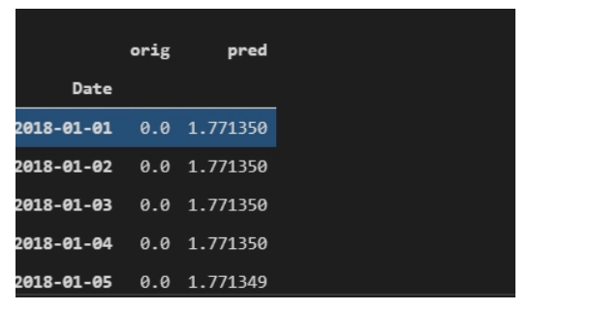
HOLT-ES TEST SCORE
Mean Absolute Error = 3.5206
Although it is less than ARIMA model, the model is actually worse.
Predicted values do not even exceed 2 mm!

Slide 46
LSTM- Long Short Term Memory
We enter the world of Deep learning to get better results using a well known implementation of a neural network for time series data, LSTM. It is an advancement of Recurrent neural networks which use forget gates to keep on the required information stored. It has been widely applied in Stock market technical analysis. The fully connected layers in the network are in fact cells in LSTM, which provide error flow to be smooth between gates. This allows us to

Slide 47
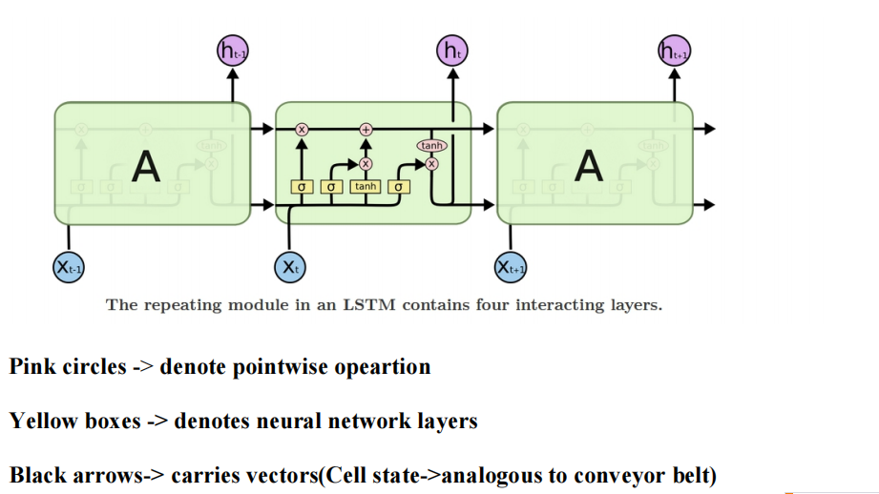

Slide 48
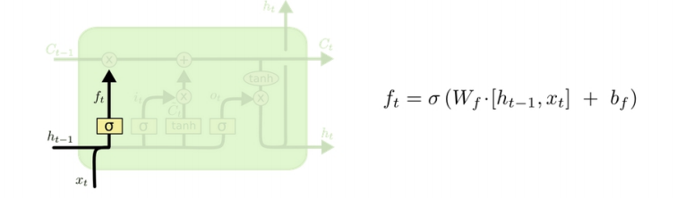
The cell state carries information seamlessly throughout cells. Gates such as the Sigmoid activation layer which usually outputs either a 0 or 1. a 0 will mean that no data can be passed to the pink circle, which is where the pointwise operation happen such as a dot product.

Slide 49
Here the previous cell output(h[t-1]) and input(x[t]) are concatenated and flow through the sigmoid gate which either outputs 0 or 1. If 0 is outputted then the information is rejected and not used, hence this gate is called forget gate.

Slide 50
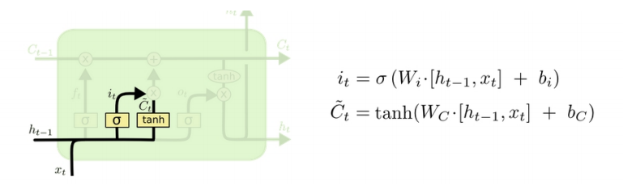
We go over our next gate, which involves using the previous value we have forgotten to create a new candidate for cell state Ct. Using the tanh activation aides in creating this new vector and updating our cell state.

Slide 51
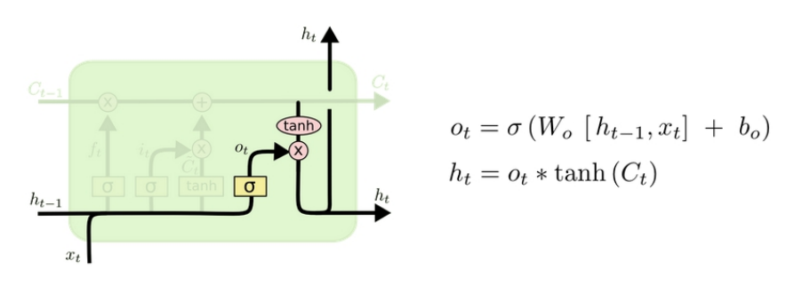
The last stage of the LSTM, is to decide what to output. Again the input goes through a sigmoid gate to decide what information to keep and a final tanh activation layer to convert the values in between -1 to 1.

Slide 52
LSTM TEST ACCURACY
The training error produced is lower than previous models(mean absolute error)-> 1.9907
Mean Absolute Error(Test Dataset)->2.955
The problem in our forecast? Only 30 values out of 334 are Non-zero, hence our prediction is Sparse!

Slide 53
What are the problems with our dataset?
The data is sparse, as many months pass in Vellore without a millimeter of rainfall. Hence 80.34% of our data is 0.0 mm
Seasonality should be present but is not present within a specific period, hence lag values differ from district to district and year to year. Indicating that the stochastic component(Zt) must be high
You cannot apply regression techniques to time series data!
The last point is problematic as it limits our modelling process to only statistical models and deep learning models. Regression cannot be applied to data which is autocorrelated.

Slide 54
Transforming our timeseries dataset to regular dataset
We generate new features from out dataset using feature engineering. A total of 12 new features are to be generated, the first 3 being easily obtained from the date feature.
• Month •
Year •
Day
is_rain•
PreviousN(where N is >=1 and <=8)
Month,Day and Year are obtained from stripping the date column using datetime library, whereas PreviousN is extracted using the following approach. is_rain is our feature to provide seasonality to the model and is basically telling the model how much rainy this month usually experiences

Slide 55
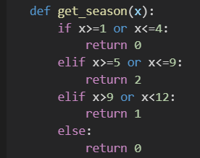
Is_rain feature
We take each month and assign levels of rainy season to them. These level range from [0,1,2]. We use a function to classify each month to these levels called get_season1, where x is the month in integer(1-Jan,2-Feb...)

Slide 56
Previous N Feature
This feature is basically asking a question to our dataset.
What was the rainfall on Day d, Month m, district D and year N?
Where N is from 1 to 8. we are using past data as a feature as we normally would in time series forecast, except the past data is having a large difference of 1 year, meaning 365 days.
To create this feature, we create Hash(dictonary) with the key being a string
District_Day_Month -> Key
[2.0,0.0,1.0,....]-> Array of length N, where N is 8 meaning 8 years of data for the partiuclar day of that particular month and district.

Slide 57
Previous N Feature
Now we have our hash, we will apply it as follows,
hash[key][0]---> Previous 1 column
hash[key][0]---> Previous 2 column..... so on till Previous 8
The problem
Our array contains values that have high variance and using them will confuse the model more. We can either scale the array, but the element of each array will be applied to a different column not the same one!
Hence, we map the values to categorical values, or a scale.

Slide 58
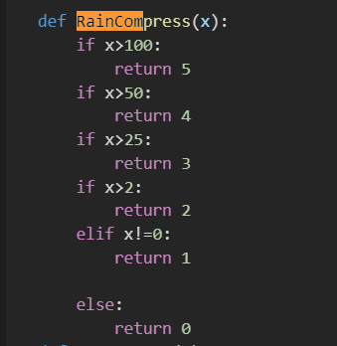
Previous N Feature
We use a function called RainCompress, Its logic is as follows
0<x <2 level 1
2<= x<25 level 2
25<= x<50 level 3
50<=x<100 level 4
100<=x level 5
x= 0 level 0
Hence the final output to be stored in the column will be like this
hash[key][0]--->RainCompress(hash[key][0])---> Previous 1 column

Slide 59
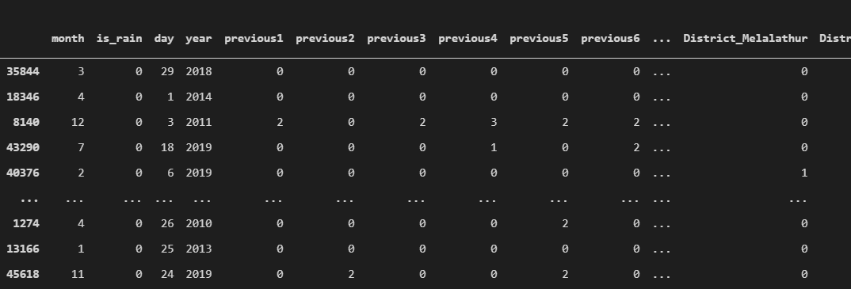
The advantage in recreating our dataset in order to fit regression models, is that a single model will be enough to forecast any district. It will consider district a separate feature and save us time and resources to dedicate distinct models for each district. We use one-hot encoding to convert the categorical district values to binary values of 0 and 1.

Slide 60
Creating Linear Regression Baseline model
In order to apply various regression based techniques, we need to start with the basics. We apply Linear regression to create a baseline. Mean Absolute Error on test dataset is 3.5203
Although it seems an acceptable error for a baseline model, the predictions are not acceptable for our usecase, as the forecast contains negative values!

Slide 61
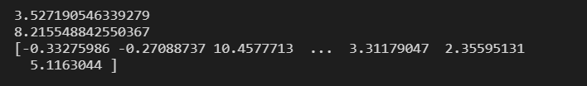

Slide 62
Support vector Regression Model
Before understanding SVR, it is important to understand SVM, which is the predecessor of SVR.
SVM(Support vector machines) is a great model used to solve classification problems.
It is even able to classify data which is not linearly separable. The intuition behind the algorithm is to raise the dimensions of the data and find a hyperplane that separates the data into classes. Below are the key parameters used in SVM

Slide 63
Kernel: It is a function which helps save our computational resources in finding the right hyperplane. Normally transforming the data into higher dimensions becomes computationally intensive proportional to the dimension being raised.
Hyperplane: The line distinguishing between the classes in our model and aiding further classification of data being inputted. For SVR, this same hyperplane will be forecasting continuous values.

Slide 64
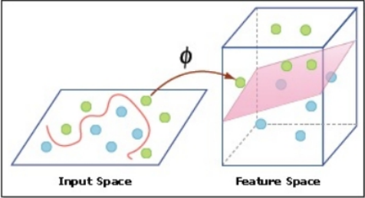
Decision Boundary: it is a line which has two sides, one being the positive side and other being the negative side. Data point within the positive side of a hyperplane belong to a specific class and on the negative side, the data points do not belong to that particular class.

Slide 65
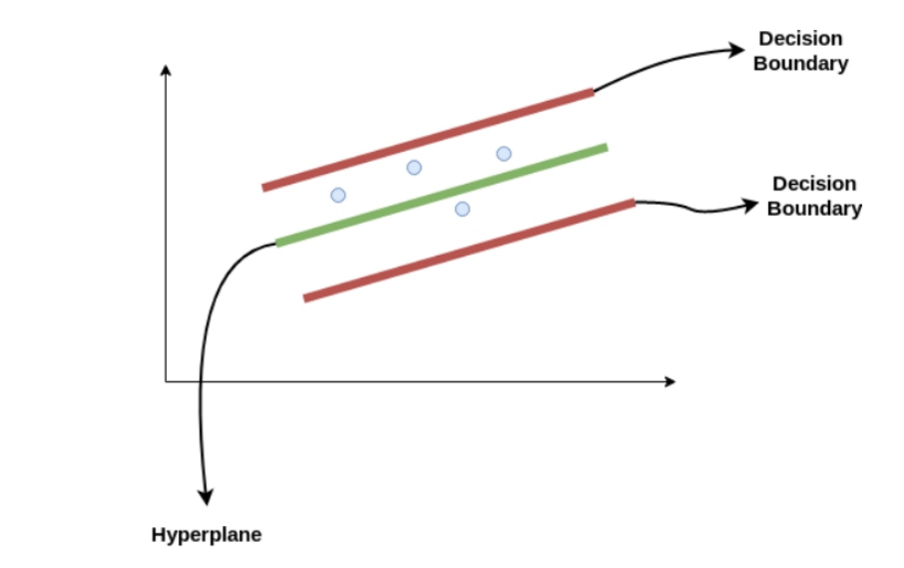
SVR utilizes almost the same algorithm, except that instead of classifying data points, we use the decision boundary lines and hyperplane to find the best fit line for our regression usecase. We assume a distance “c”(epsilon) between the hyperplane and decision boundary line.
Hyperplane: y=wx+b
Decision boundary lines: wx+b= c,
wx+b= -c

Slide 67
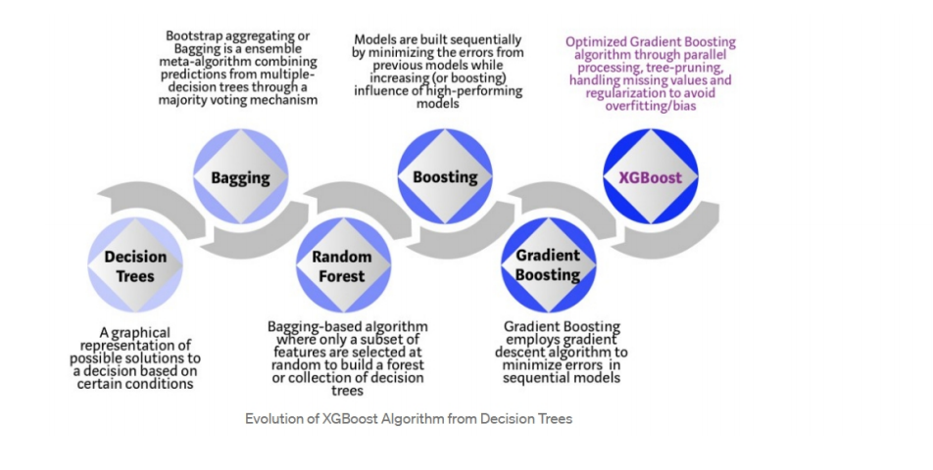
XGBOOST REGRESSOR
Gradient boosting refers to an ensemble technique, where boosting implies the models are added sequentially in the ensemble. It uses multiple decision trees and weights are assigned to these trees to quantify their say to the final output. The trainable parameters are learned through gradient descent, hence the name gradient boosting

Slide 68
XGBoost enhances Gradient boosting algorithm by reducing the training time significantly via hardware optimizations. XGBoost also has sparse data handling capabilities, which is perfect for our dataset, it does not simply replace zeroes with the averages, but by “learning” best fit values for sparse data. We implement XGBoost using its open-source library, with hyperparameters n_esitmators 3(the number of trees) and max_depth=35 to see how much depth a tree is allowed to go.

Slide 69
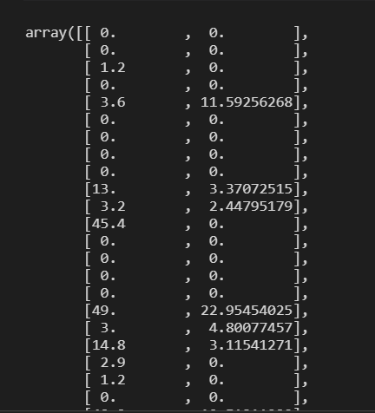
Mean Absolute Error of test data -> 1.57
The model has learned to predict that when it is not raining it will be return 0.0 to make sure the predictions are not sparse and non-negative values. We will utilize this model along with other models in upcoming dashboard

Slide 70
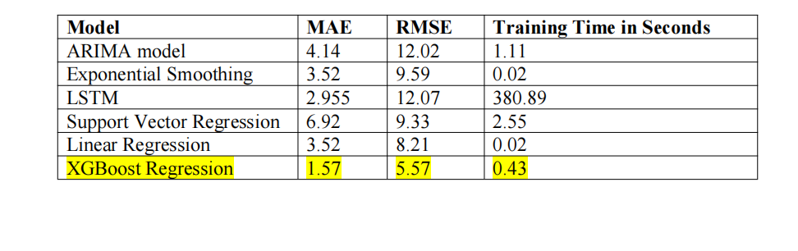
Conclusion

Slide 71
Website link
https://rain-forecast.herokuapp.com/

Slide 72
THANK YOU

